Slide 1
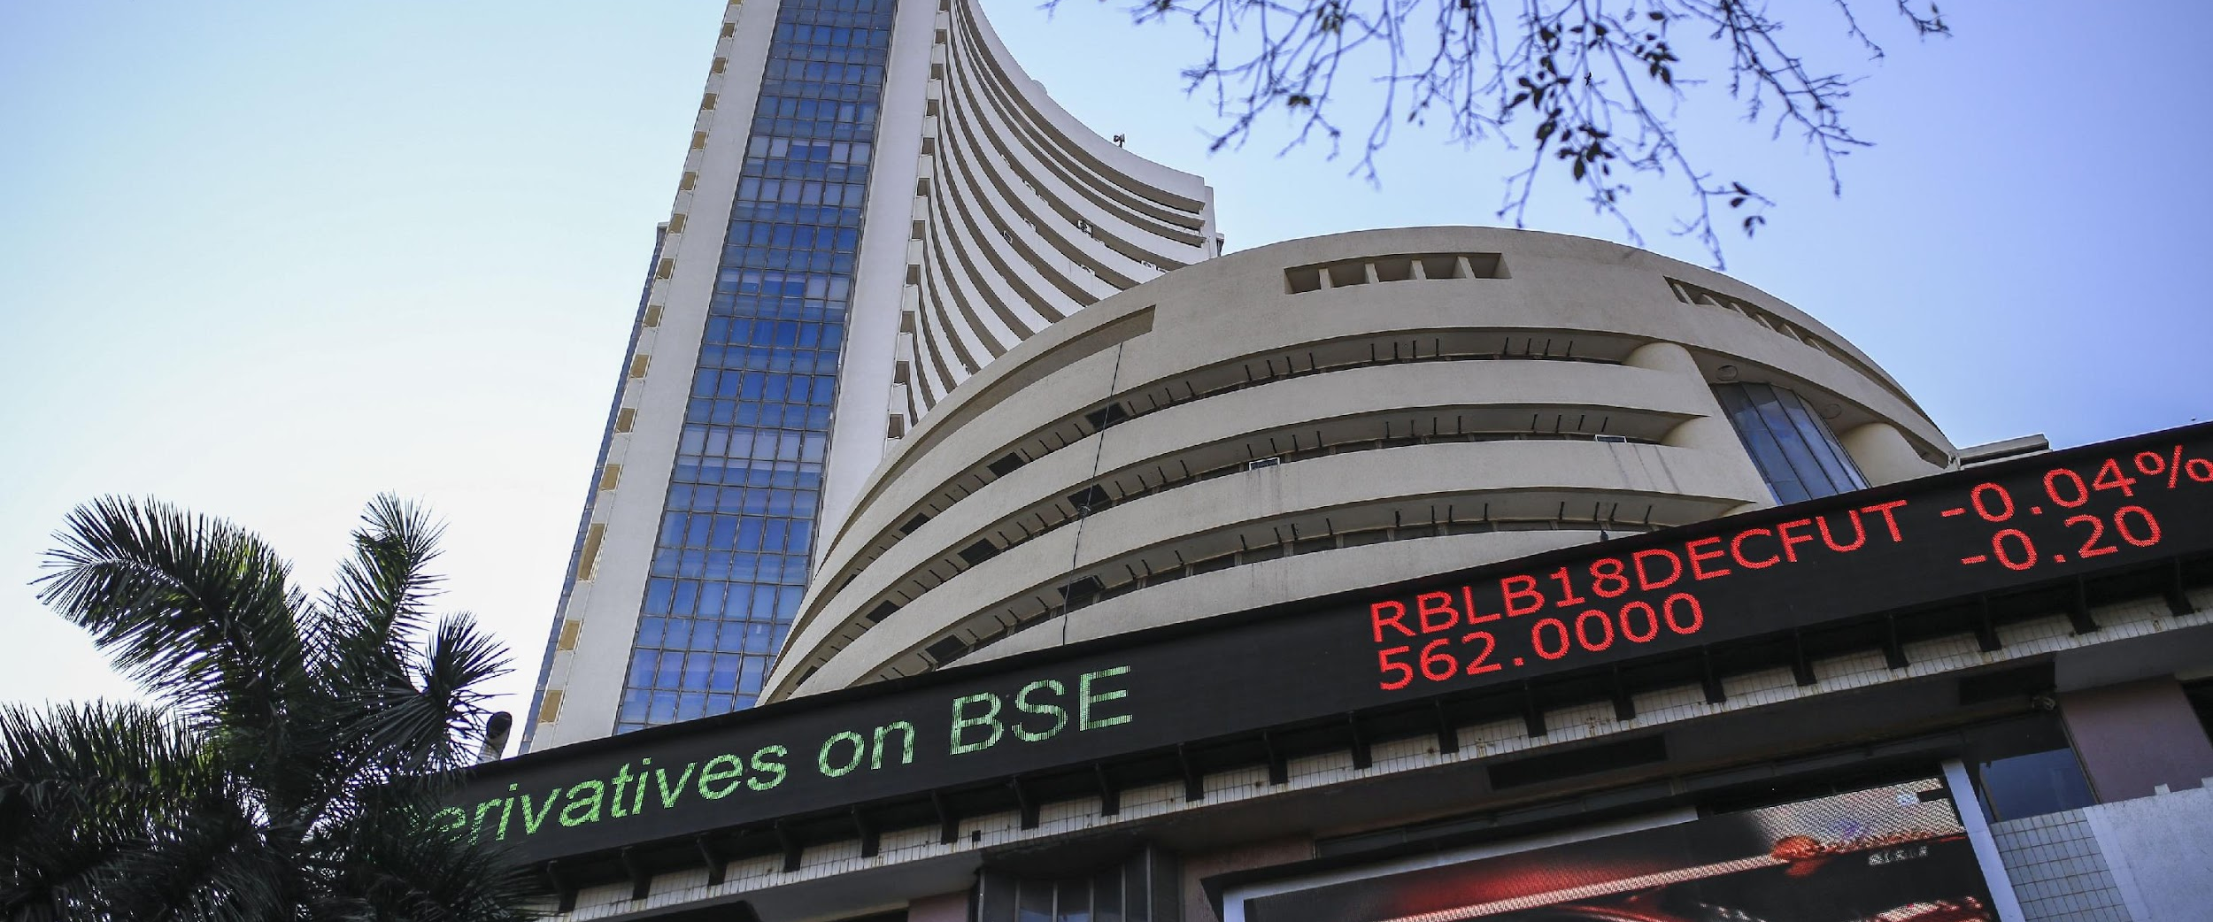
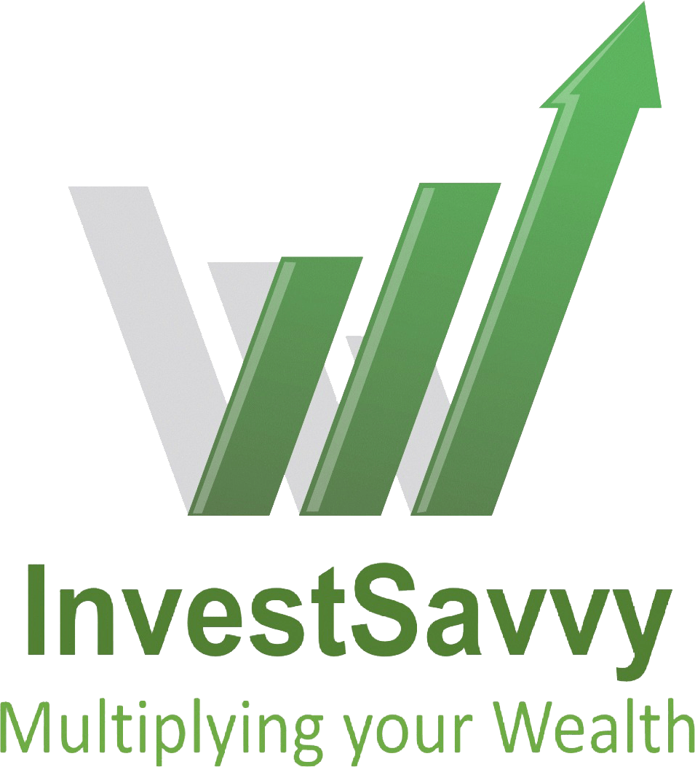
InvestSavvy Portfolio Management LLP
Multiplying Your Wealth
"How many millionaires do you know who have become wealthy by investing in savings accounts? I rest my case."
— Robert G. Allen
31st July 2024

Slide 2
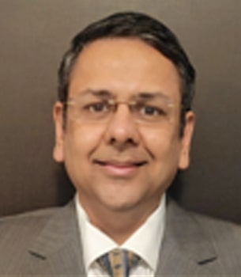
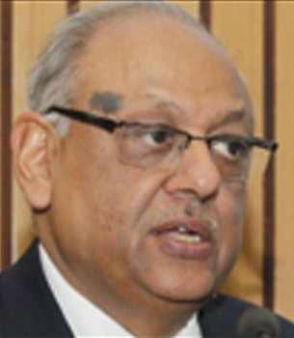
Partners
Managing Partner & Principal Officer:
Ashish has over 25 years of experience in Financial Markets. Has was MD - Standard Chartered Bank, Bear Stearns, Dresdner Bank, Safron Ltd(Hedge Fund) and ICICI.
Has worked in US, UK, India and Singapore.
Class topper at Carnegie Mellon University, MS (Computational Finance), IIM Calcutta (MBA Finance) rank holder and IIT Kanpur (B.Tech. EE & CSE).
A former civil servant, who joined IAS in 1972, and served in various key positions in Uttar Pradesh and 6 Ministries in Govt of India including Finance & Civil Aviation, before superannuating as Secretary, Corporate Affairs in 2009.
He was also Member, SEBI Board ( 2006-09) and
Member, Competition Commission of India ( 2009-14), apart from being on the Boards of numerous companies over a period of more than two decades.
He is leading Shaping Tomorrow Consultants LLP, a future, technology and sustainability focused entity he founded in end 2014, and has since been advising UNDP, governments, academia, industry and various other organizations.

Slide 3
Investment
Why India?
Stable Government
China + 1
Large English speaking educated workforce
Demographic Dividend: Affluent population growing.
Government focus on Economic Growth, investment into Infrastructure, Digitisation, STP
Huge benefits due to GST to corporates
Why Equities?
Shift in Investment allocation
Move from unorganised (small operators) to organized sector (listed)
Technology – cutting out middlemen
Taxation, liquidity, returns, ease of access & all digital.
Notes:
Government Initiatives/Infrastructure
India's real GDP will grow at more than 6% every year between 2023 and 2028. expects India's real economic growth to be 6.5% in 2023 and 6.3% in 2024, which is the highest among large economies in the region.
India's affluent population is likely to hit 100 million by 2027. Goldman Sachs Research projects India will have the world's second-largest economy by 2075.
Chetan – builder – says the business has basically moved

Slide 4
Stock Filtering process
01
Identify Stocks having a compelling story/MOAT which are potential multi-baggers. Carry out Relative Valuation.
Intrinsic Valuation: Fundamental analysis done to arrive at the intrinsic value of the stock. Then look at stocks that are undervalued to allow for a Margin of Safety
03
02
Technical Analysis: Look at the price behavior to identify appropriate entry and exit points.

Slide 5

Investment Ethos
Flexibility in size:
Value Stocks
As a new fund, we even evaluate & invest in companies with a market cap of a few hundred crores. These are companies that can grow at a much faster pace if the underlying story is strong. Large established Mutual funds typically do not invest in companies with a market cap of less than 5000 Cr.
Inherently – in a market that is not shooting up, value stocks generally tend to do better than very highly priced stocks. E.g. Twitter revenues were at 7X in 2022 then that of 2013 but the stock price was lower than than it was in 2013. So, unless there is a strong reason – we give lot of weightage to valuation. That said, we always keep an open mind. E.g. I personally bought Saregama at 80P/E, as there was a strong story behind it, and it has gone more than 10X.
Debt
We generally prefer to have a company where the debt level is low.
That said, in case the debt is primarily on account of CAPEX for Growth, with a plan to pay off in the short to medium term, or the company is being restructured with a change in management, then we could still invest if we believe that potential upside far out ways the risk. E.g. I bought CG Power when it was hugely in debt, and it has been a superb turnaround story with the stock going 20X in 1 year.
Margin of Safety
The fund looks at companies that have an intrinsic value that is more than the market cap. Based on Sector outlook, Financials, interactions with management etc. we do a DCF valuation of the company. This allows us to get an idea of the margin of safety for our investments.

Slide 6
Tactical Investing
Special Situations: E.g., Stock ABC vs XYZ. Swap ratio was 1:2. We were inherently bullish on the merged entity. Hence, we stay long in the stock that is cheaper and switch from the more expensive one – saving 5-10% each time.
Annual Market Cycles: There are periods that we have identified where markets are more likely to give +ve or –ve returns. We change the proportion of cash held to benefit from the same.
Impact of events/changes in prices on sectors: These could be short term aberrations that could lead to opportunities. E.g., Export duty on Steel, war & freight charges, rubber price fall.

Slide 7

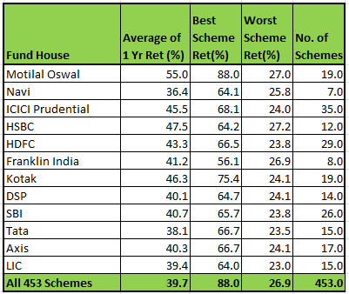
Performance
The fund has outperformed all benchmarks and all Mutual Funds (excl Sectoral/thematic funds) since inception.
InvestSavvy 1year returns are at 74% which are better than all but 3 MF scheme across all 440 schemes listed.(source: Valueresearchonline.com) . Have tabled returns of the major fund house schemes and totals below:
*Performance data is as on 31st July and investment approach provided herewith, is not verified by SEBI
**Returns beyond 1 year are annualized.

Slide 8
Performance
The fund has outperformed all benchmarks consistently since inception.
This flows from the philosophy of multiplying wealth and not just trying to mirror the market returns
*Performance data and investment approach provided herewith, is not verified by SEBI

Slide 9
Performance
As per PMS Bazaar as on 30 Jun 2024 rankings, we were rated:
          No. 2 in 2 years 75.5% annualized returns
          No. 6 in 1 year with 93.6% abs. return
          Top 10 in 3 months 29% abs. return
          We were also amongst the Top 10 funds for:
          FY 24
          CY 23
*Performance data and investment approach provided herewith, is not verified by SEBI

Slide 10
Infrastructure/Support:
In order to provide best in class service to the clients, we have tied up with edelweiss for all Fund accounting, Custody, Broking, Back office, reporting functions. This allows us to offer top end infrastructure and support to our clients.
We use wealth spectrum, which is the most respected industry standard system. It allows multiple ways of slicing and dicing the portfolio. The account reports were generated by the same.
We have subscribed to industry data providers like ACE Equities in order to get reliable data about the company's numbers
We also use advanced technical tools that allow for real time monitoring of our holdings and trends.
We have hired an HR firm for all HR related reporting’s and filings etc.
We have also hired a CA firm to assist our Compliance and Operations manage accounts.

Slide 11

THANK YOU
“Always deliver more than expected.”
Larry Page, Co-Founder, Google
Email crm@investsavvy.in Website https://investsavvy.in/ Mobile/Whatsapp 8928293936

Slide 12
Disclaimer and Other Important Information
Not an offer and confidential: This presentation and the information in it is provided for your internal use only. The information contained herein is proprietary and confidential to Akena (the “Advisor”) and may not be disclosed to third parties or duplicated or used for any purpose other than the purpose for which it has been provided. Although the information provided herein has been obtained from sources which the Adviser believes to be reliable, we do not guarantee its accuracy, and such information may be incomplete or condensed. The information is subject to change without notice. This communication is for information purposes only and is not intended as an offer or solicitation with respect to the purchase or sale of any security or of any fund or account (a “Fund”) the Adviser manages or offers. Since we furnish all information as part of a general information service and without regard to your particular circumstances, the Adviser shall not be liable for any damages arising out of any inaccuracy in the information.
The information contained in it should not be the basis of an investment decision. An Investment decision should be based on your customary and thorough due diligence procedures, which should include, but not be limited to, a thorough review of all relevant term sheets and other offering documents as well as consolation with legal, tax and regulatory experts. Any person subscribing for an investment must be able to bear the risks involved and must meet the particular Fund’s suitability requirements. Some or all alternative investment programs may not be suitable for certain investors. No assurance can be given that any Fund will meet its investment objectives or avoid losses. A discussion of some, but not all, of the risks associated with investing in the Fund can be found in the Fund’s private placement memoranda, subscription agreement, limited partnership agreement, articles of association or other offering documents as applicable (collectively the “Offering Documents”), among those risks, which we wish to call to your attention, are the following:
Future looking statements, Performance Data and strategy level performance reporting: The information in this presentation is NOT intended to contain or express exposure recommendations, guidelines or limits applicable to a Fund. The information in this report does not disclose or contemplate the hedging or exit strategies of the Fund. While investors should understand and consider risks associated with position concentrations when making an investment decision, this report is not intended to aid an investor in evaluating such risk. The terms set forth in the Offering Documents are controlling in all respects should they conflict with any other term set forth in other marketing materials, and therefore, the Offering Documents must be reviewed carefully before making an investment and periodically while an investment is maintained. Statements made in this release include forward-looking statements. These statements, including those relating to future financial expectations, involve certain risks and uncertainties that could cause actual results to differ materially from those in the forward-looking statements. Unless otherwise indicated, Performance Data is presented unaudited and “net” of management fees and other fund expenses (i.e. legal and accounting and other expenses as disclosed in the relevant Fund’s Offering Documents”) and net of performance allocations. Due to the format of data available for the time periods indicated, both gross and net returns are difficult to calculate precisely. Accordingly, the calculations have been made based on in some cases limited available data and a number of assumptions. Because of these limitations, the performance information should not be relied upon as a precise reporting of gross or net performance, but rather merely a general indication of past performance.
The performance information presented herein may have been generated during a period of extraordinary market volatility or relative stability in a particular sector. Accordingly, the performance is not necessarily indicative of results that the Fund may achieve in the future. In addition, the foregoing results may be based or shown on an annual basis, but results for individual months or quarters within each year may have been more favorable or less favorable than the results for the entire period. If index information is included, it is merely to show the general trend in the markets in the periods indicated and is not intended to imply that the portfolio was similar to the indices in either composition or element of risk. This report may indicate that it contains hypothetical or actual performance of specific strategies employed by The Adviser, such strategies may comprise only a portion of any specific Fund’s portfolio, and, therefore, the reported strategy level performance may not correspond to the performance of any Fund for the reported time period.
Investment Risks: Investing in the Fund is speculative and involves varying degrees of risk, including substantial degrees of risk in some cases. The Fund may be leveraged and may engage in other speculative investment practices that may increase the risk of investment loss. Past results of the Fund investment manager is not necessarily indicative of future performance of the Fund, and the Fund’s performance may be volatile. The use of a single advisor could mean lack of diversification and, consequently, higher risk. The Fund may have varying liquidity provisions and limitations. There is no secondary market for investors’ interests in the Fund and none is expected to develop.
Not Legal, Accounting or Regulatory Advice: This material is not intended to represent the rendering of accounting, tax, legal or regulatory advice. A change in the facts or circumstances of any transaction could materially affect the accounting, tax, legal or regulatory treatment for that transaction. The ultimate responsibility for the decision on the appropriate application of accounting, tax, legal and regulatory treatment rests with the investor and his or her accountants, tax and regulatory counsel. Potential investors should consult, and must rely on their own professional tax, legal and investment advisors as to matters concerning the Fund and their investments in the Fund. Prospective investors should inform themselves as to: (1) the legal requirements within their own jurisdictions for the purchase, holding or disposal of investments; (2) and applicable foreign exchange restrictions; and (3) any income and other taxes which may apply to their purchase, holding and disposal of investments or payments in respect of the investments of the Fund.

